Slide 1
KISMET – tvarių maisto sistemų
kūrimas Vilkaviškyje
^{Sausio 24, 2024}
^{Giedrė Ramanauskienė}
interreg-baltic.eu/project/kismet

Slide 2
Tikslas – kartu su vietos bendruomenėmis kurti tvaras maisto sistemas Baltijos jūros regiono šalyse.
Notes:
Based on a pilot case we decided that the strategy should be created on the following criteria:
The plan will make use of key facts and figures, specific to the local food sector.
The strategy must effectively communicate the significance of these data in order to engage decision-makers.
The plan will show the true cost of dietary (dajetary) options by demonstrating the real cost of food.
The document will provide solutions and stress the positive elements of change.
In order to do this, we intend to:
Organize a local workshop to create the strategy, milestones, instruments, and execution metrics for the communication plan.
Create a plan for local communication that will enhance the food supply strategy of Vilkaviskis municipality and foster discussion with stakeholders to achieve local goals.
Boost the municipality's ability to work with small-scale players to create a sustainable food environment.
The question was, Where should we start this journey?

Slide 3
Aplinkosauginė darna
Ekonominė nauda
Socialinė atsakomybė
Tvari maisto sistema - maisto tiekimo ir vartojimo būdas, kuris siekia ilgalaikių ekologinių, socialinių ir ekonominės darnos tikslų.
Tvarumas
Notes:
Based on a pilot case we decided that the strategy should be created on the following criteria:
The plan will make use of key facts and figures, specific to the local food sector.
The strategy must effectively communicate the significance of these data in order to engage decision-makers.
The plan will show the true cost of dietary (dajetary) options by demonstrating the real cost of food.
The document will provide solutions and stress the positive elements of change.
In order to do this, we intend to:
Organize a local workshop to create the strategy, milestones, instruments, and execution metrics for the communication plan.
Create a plan for local communication that will enhance the food supply strategy of Vilkaviskis municipality and foster discussion with stakeholders to achieve local goals.
Boost the municipality's ability to work with small-scale players to create a sustainable food environment.
The question was, Where should we start this journey?

Slide 4
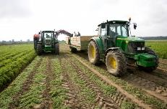
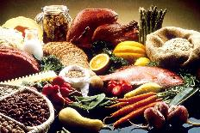
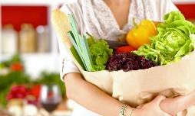
Trumpa maisto vertės grandinė
Tarp augintojo ir vartotojo – ne daugiau kaip 1 tarpininkas;
Produktai auginami, gaminami, vartojami kuo glaudesnėje teritorijoje (iki 50–70 km atstumu);
Gamintojas ne tik tiekia produktus, bet ir su galutiniu vartotoju tiesiogiai keičiasi informacija apie produktų auginimą, paruošimą, vartojimą, jų vertę žmogaus sveikatai, įtaką gamtai.
Žaliavos tiekėjas
Gamintojas
Vartotojas

Slide 5
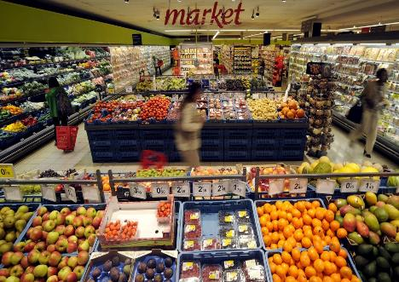
Vartotojų įpročiai
Pagrindinė apsipirkimo vieta – prekybos centrai;
Vyrauja įvežtiniai maisto produktai;
Maža rinkos įvairovė, dominuoja masinė produkcija;
Iki 60 % populiacijos mitybos sudaro perdirbti produktai;
Kaina išlieka svarbiausiu pasirinkimo prioritetu.
Notes:
Based on a pilot case we decided that the strategy should be created on the following criteria:
The plan will make use of key facts and figures, specific to the local food sector.
The strategy must effectively communicate the significance of these data in order to engage decision-makers.
The plan will show the true cost of dietary (dajetary) options by demonstrating the real cost of food.
The document will provide solutions and stress the positive elements of change.
In order to do this, we intend to:
Organize a local workshop to create the strategy, milestones, instruments, and execution metrics for the communication plan.
Create a plan for local communication that will enhance the food supply strategy of Vilkaviskis municipality and foster discussion with stakeholders to achieve local goals.
Boost the municipality's ability to work with small-scale players to create a sustainable food environment.
The question was, Where should we start this journey?

Slide 6
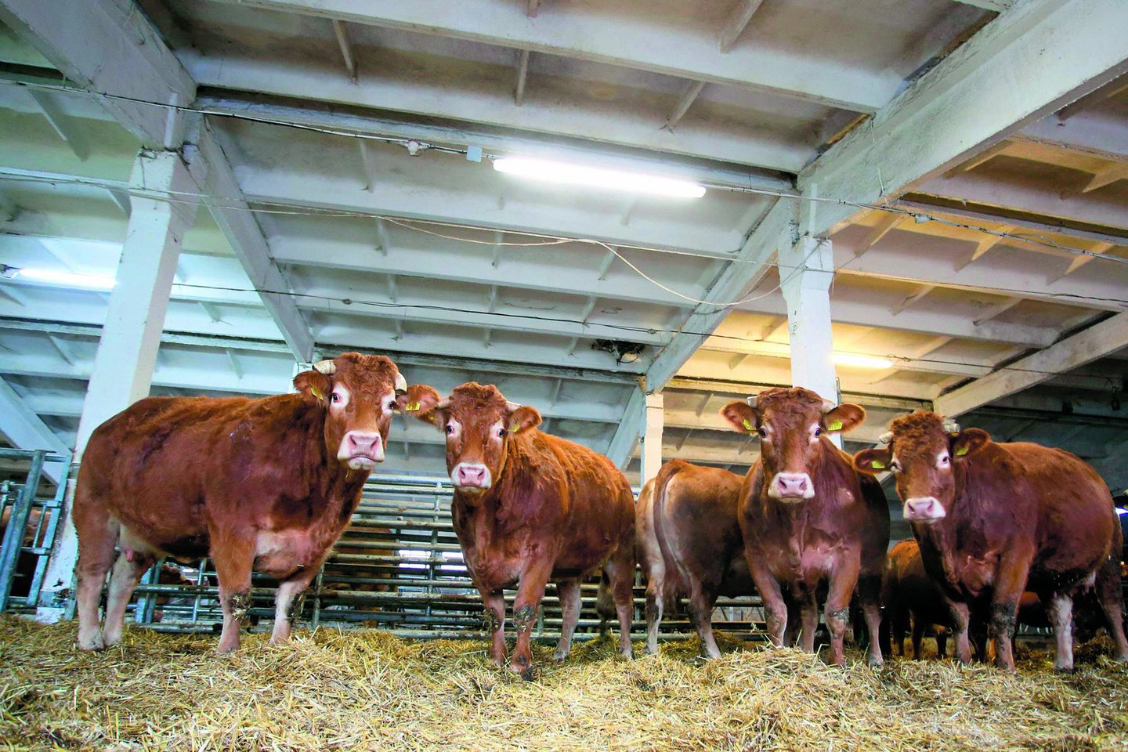
Augintojų ir gamintojų įpročiai
Tik 4 proc. ūkininkų parduoda daugiau kaip 50 proc. savo produkcijos tiesiogiai vartotojams;
2023 m. Lietuvoje veikė 29 žemės ūkio kooperatyvai. Vilkaviškyje - 3;
Ūkininkams trūksta motyvacijos (laikas, maži kiekiai, papildomos išlaidos) realizuoti produkciją galutiniams vartotojams;
Nepakankami verslumo įgūdžiai.
Notes:
Based on a pilot case we decided that the strategy should be created on the following criteria:
The plan will make use of key facts and figures, specific to the local food sector.
The strategy must effectively communicate the significance of these data in order to engage decision-makers.
The plan will show the true cost of dietary (dajetary) options by demonstrating the real cost of food.
The document will provide solutions and stress the positive elements of change.
In order to do this, we intend to:
Organize a local workshop to create the strategy, milestones, instruments, and execution metrics for the communication plan.
Create a plan for local communication that will enhance the food supply strategy of Vilkaviskis municipality and foster discussion with stakeholders to achieve local goals.
Boost the municipality's ability to work with small-scale players to create a sustainable food environment.
The question was, Where should we start this journey?

Slide 7
Trumpų maisto grandinių ekonominis poveikis
Smulkių gamintojų prieiga prie rinkos
Vietinės ekonomikos palaikymas
Geresnė prieiga prie šviežio, sezoninio ir aukštesnės kokybės maisto
Aukštesnės pelno maržos iš mažesnio skaičiaus tarpininkų
Sąžiningesnės kainos ūkininkams
Notes:
Based on a pilot case we decided that the strategy should be created on the following criteria:
The plan will make use of key facts and figures, specific to the local food sector.
The strategy must effectively communicate the significance of these data in order to engage decision-makers.
The plan will show the true cost of dietary (dajetary) options by demonstrating the real cost of food.
The document will provide solutions and stress the positive elements of change.
In order to do this, we intend to:
Organize a local workshop to create the strategy, milestones, instruments, and execution metrics for the communication plan.
Create a plan for local communication that will enhance the food supply strategy of Vilkaviskis municipality and foster discussion with stakeholders to achieve local goals.
Boost the municipality's ability to work with small-scale players to create a sustainable food environment.
The question was, Where should we start this journey?

Slide 8
Trumpų maisto grandinių aplinkosauginis poveikis
Geresnės laikymo sąlygos gyvūnams
Prioritetas organiniam maistui
Maži atstumai tarp gamintojo ir vartotojo
Naudojamos minimalios arba aplinkai draugiškos pakuotės
Mažesnis maisto švaistymas
Notes:
Based on a pilot case we decided that the strategy should be created on the following criteria:
The plan will make use of key facts and figures, specific to the local food sector.
The strategy must effectively communicate the significance of these data in order to engage decision-makers.
The plan will show the true cost of dietary (dajetary) options by demonstrating the real cost of food.
The document will provide solutions and stress the positive elements of change.
In order to do this, we intend to:
Organize a local workshop to create the strategy, milestones, instruments, and execution metrics for the communication plan.
Create a plan for local communication that will enhance the food supply strategy of Vilkaviskis municipality and foster discussion with stakeholders to achieve local goals.
Boost the municipality's ability to work with small-scale players to create a sustainable food environment.
The question was, Where should we start this journey?

Slide 9
Trumpų maisto grandinių socialinis poveikis
Tvirti vietiniai socialiniai ryšiai bei tinklai
Aukšta autonomija bei derybinė galia
Didesnis abipusis pasitikėjimas bei skaidrumas
Stipri kooperacija bei solidarumas vertės grandinėse
Tvirta socialinė įtrauktis
Vartotojo sąmoningumas bei žinios apie vietinė produkciją
Notes:
Based on a pilot case we decided that the strategy should be created on the following criteria:
The plan will make use of key facts and figures, specific to the local food sector.
The strategy must effectively communicate the significance of these data in order to engage decision-makers.
The plan will show the true cost of dietary (dajetary) options by demonstrating the real cost of food.
The document will provide solutions and stress the positive elements of change.
In order to do this, we intend to:
Organize a local workshop to create the strategy, milestones, instruments, and execution metrics for the communication plan.
Create a plan for local communication that will enhance the food supply strategy of Vilkaviskis municipality and foster discussion with stakeholders to achieve local goals.
Boost the municipality's ability to work with small-scale players to create a sustainable food environment.
The question was, Where should we start this journey?

Slide 10
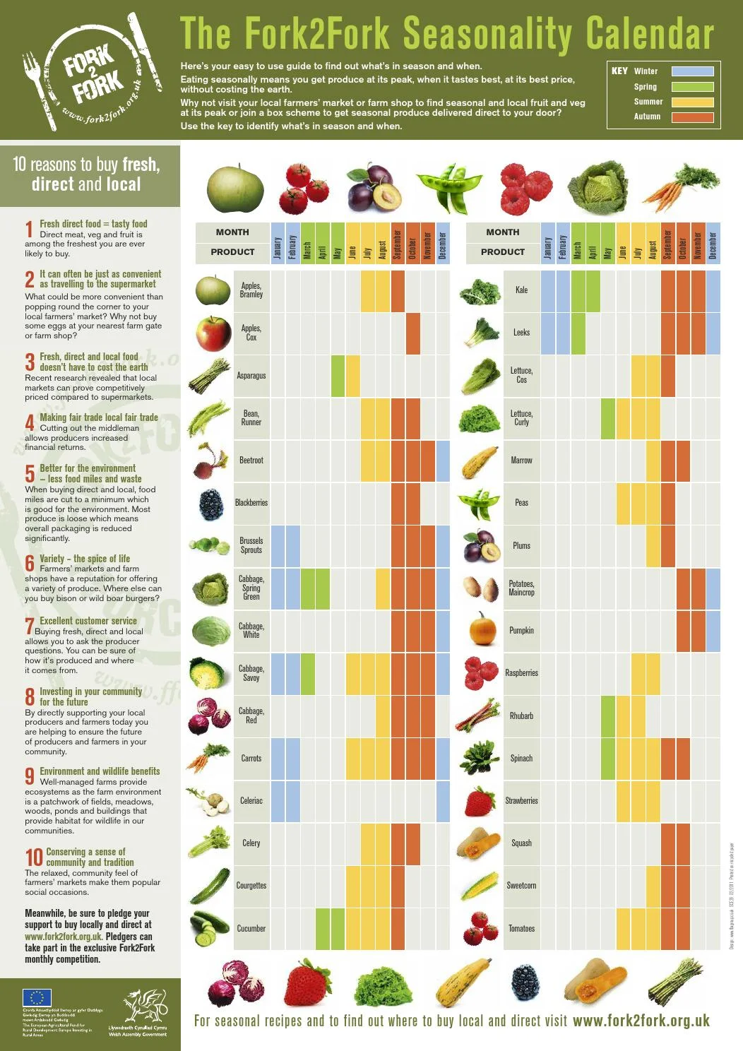
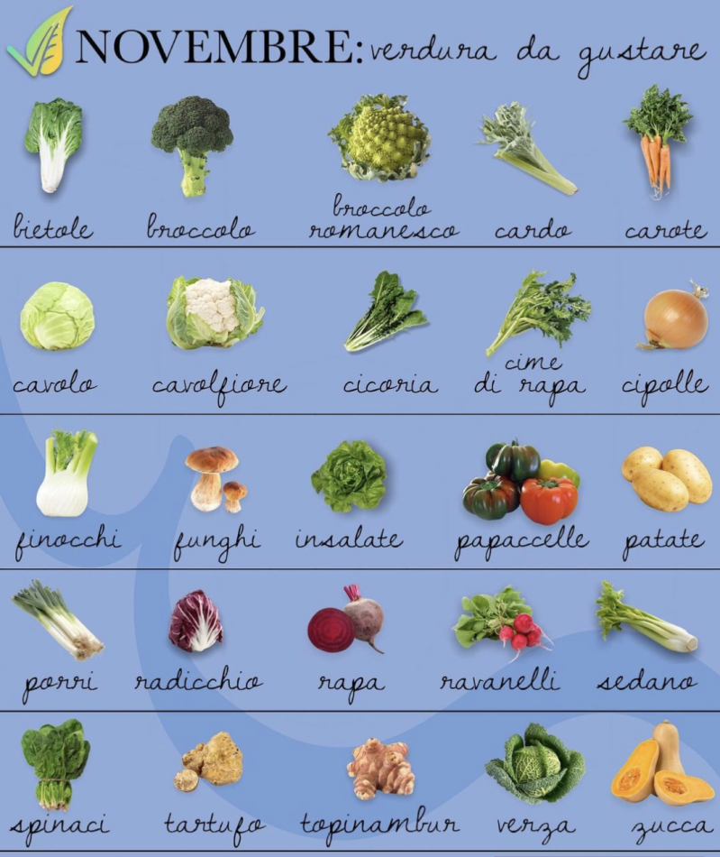
Gerieji užsienio šalių pavyzdžiai.
Sezoninio maisto vartojimo skatinimas
Notes:
Based on a pilot case we decided that the strategy should be created on the following criteria:
The plan will make use of key facts and figures, specific to the local food sector.
The strategy must effectively communicate the significance of these data in order to engage decision-makers.
The plan will show the true cost of dietary (dajetary) options by demonstrating the real cost of food.
The document will provide solutions and stress the positive elements of change.
In order to do this, we intend to:
Organize a local workshop to create the strategy, milestones, instruments, and execution metrics for the communication plan.
Create a plan for local communication that will enhance the food supply strategy of Vilkaviskis municipality and foster discussion with stakeholders to achieve local goals.
Boost the municipality's ability to work with small-scale players to create a sustainable food environment.
The question was, Where should we start this journey?

Slide 11
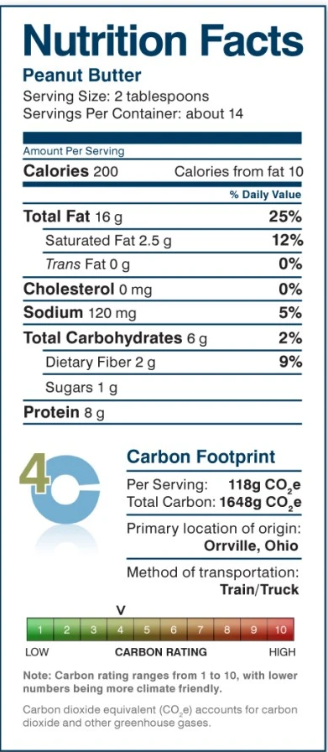
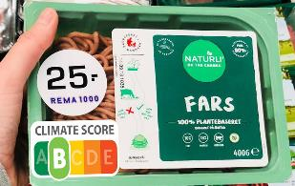
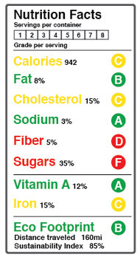
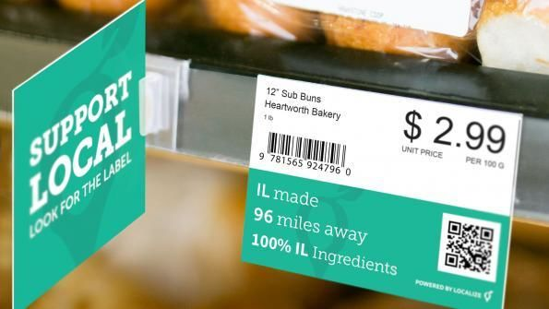
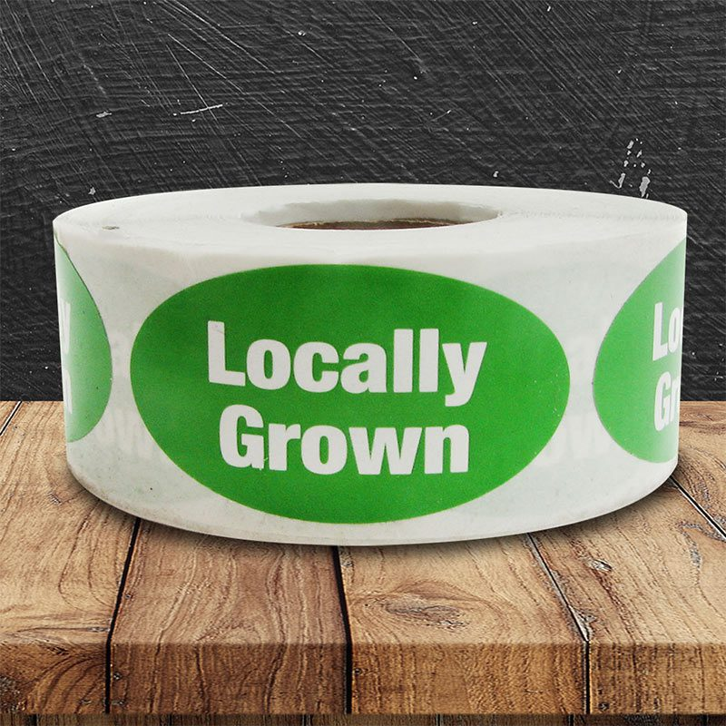
Tvaraus vietinio maisto produktų ženklinimas
Notes:
Based on a pilot case we decided that the strategy should be created on the following criteria:
The plan will make use of key facts and figures, specific to the local food sector.
The strategy must effectively communicate the significance of these data in order to engage decision-makers.
The plan will show the true cost of dietary (dajetary) options by demonstrating the real cost of food.
The document will provide solutions and stress the positive elements of change.
In order to do this, we intend to:
Organize a local workshop to create the strategy, milestones, instruments, and execution metrics for the communication plan.
Create a plan for local communication that will enhance the food supply strategy of Vilkaviskis municipality and foster discussion with stakeholders to achieve local goals.
Boost the municipality's ability to work with small-scale players to create a sustainable food environment.
The question was, Where should we start this journey?

Slide 12
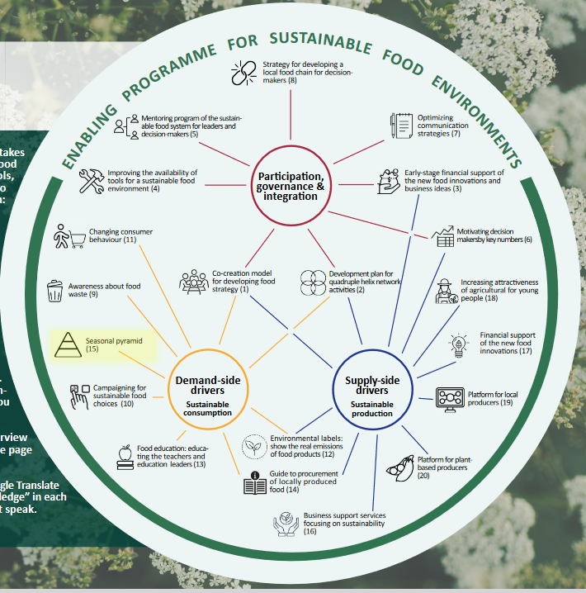
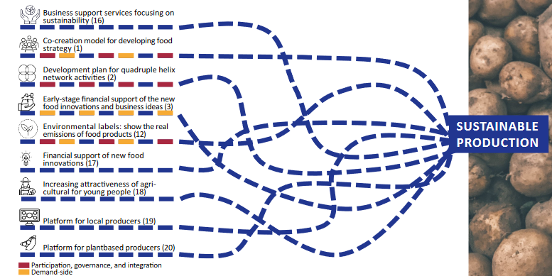
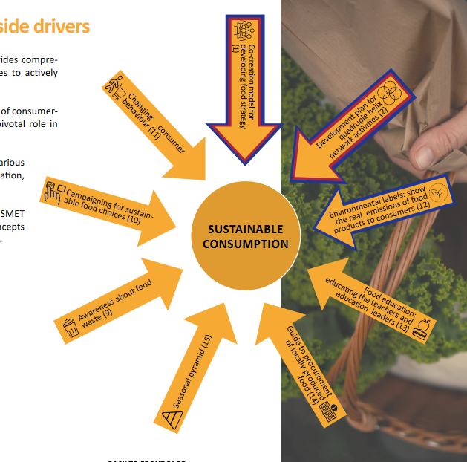
Tvaraus maisto sistemų gerųjų praktikų gidas
https://interreg-baltic.eu/project/kismet-interreg-baltic-sea-region/
Notes:
Based on a pilot case we decided that the strategy should be created on the following criteria:
The plan will make use of key facts and figures, specific to the local food sector.
The strategy must effectively communicate the significance of these data in order to engage decision-makers.
The plan will show the true cost of dietary (dajetary) options by demonstrating the real cost of food.
The document will provide solutions and stress the positive elements of change.
In order to do this, we intend to:
Organize a local workshop to create the strategy, milestones, instruments, and execution metrics for the communication plan.
Create a plan for local communication that will enhance the food supply strategy of Vilkaviskis municipality and foster discussion with stakeholders to achieve local goals.
Boost the municipality's ability to work with small-scale players to create a sustainable food environment.
The question was, Where should we start this journey?

Slide 13
Planuojamos veiklos Vilkaviškyje 2024 m.
Tvaraus maisto skatinimo strategija;
Renginiai, skirti stiprinti dialogą tarp suinteresuotų pusių;
Veiksnių, galinčių paskatinti vietos trumpųjų maisto grandinių plėtrą, identifikavimas;
Sezoninio maisto principų taikymo galimybių paieška;
Vilkaviškio atvejo viešinimas užsienyje;
Miestų bendradarbiavimas bei gerosios praktikos mainai vystant tvaraus maisto sistemas.
Notes:
And about our plans:
In the beginning of the new year, we will organize a workshop with LIP stakeholders to discuss the communication plan draft, milestones, tools, and measures for implementation. Participants will be municipality officers, business representatives, industrialists, scientists, and business support organizations.
After that, we will prepare the final version of the communication plan. At the same time, the seasonal food pyramid instrument will be presented, which will become one of the strategy implementation tools.
In April, we will organize a communication plan presentation event, during which recommendations and tips on how to use it will be presented in order to promote a sustainable food environment and create an ecosystem that supports it.
In June 2024, we are planning to develop a farming and food knowledge system to bring together different actors, resources, knowledge kits, municipalities, and entrepreneurship centers in the LIP.
In August 2024, we are planning the workshop to help find drivers and ways to foster public sector demand for food quality and sustainability.
In the end, I want to present to you the short film about the Vilkaviskis local food producers. The film is in lithuanian, but you will see English subtitles. It will take about 10 minutes. After that, you can ask the questions.

Slide 14
Kontaktai
GIEDRĖ RAMANAUSKIENĖ
g.ramanauskiene@lic.lt
INGA VYŠNIAUSKIENĖ
i.vysniauskiene@lic.lt

